Slide 1
CyberMI Reporting
BCS UK IT Industry Awards 2021
Best User Engagement Project of the Year
Vince King
September 2021

Slide 2

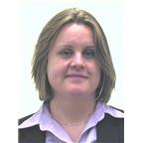
Introductions
Vincent King
MBCS RITTech CITP CISSP
Cyber Analyst
Technical Vulnerability & Management
Agenda
Introductions
What we did
Why we succeeded
Questions
Jo Derbyshire
MBCS
Manager
Insider Threat Governance
Notes:
Vince King / Reformed developer-manager-now Cyber Analyst within TVM / MBCS for 20 years / Recent RITTech and CITP

Slide 3



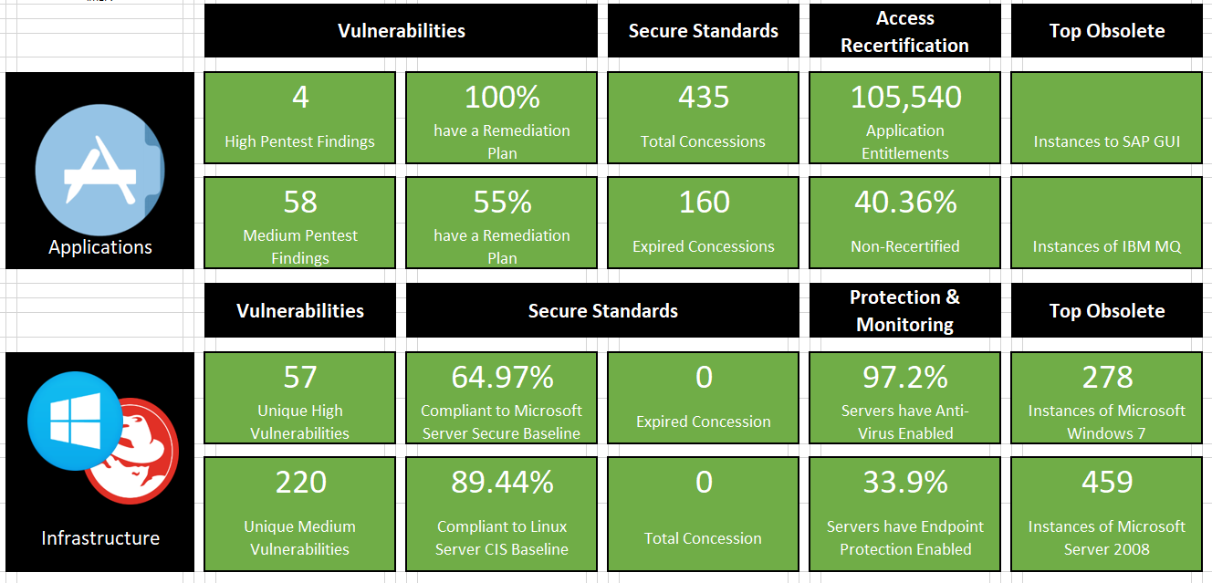


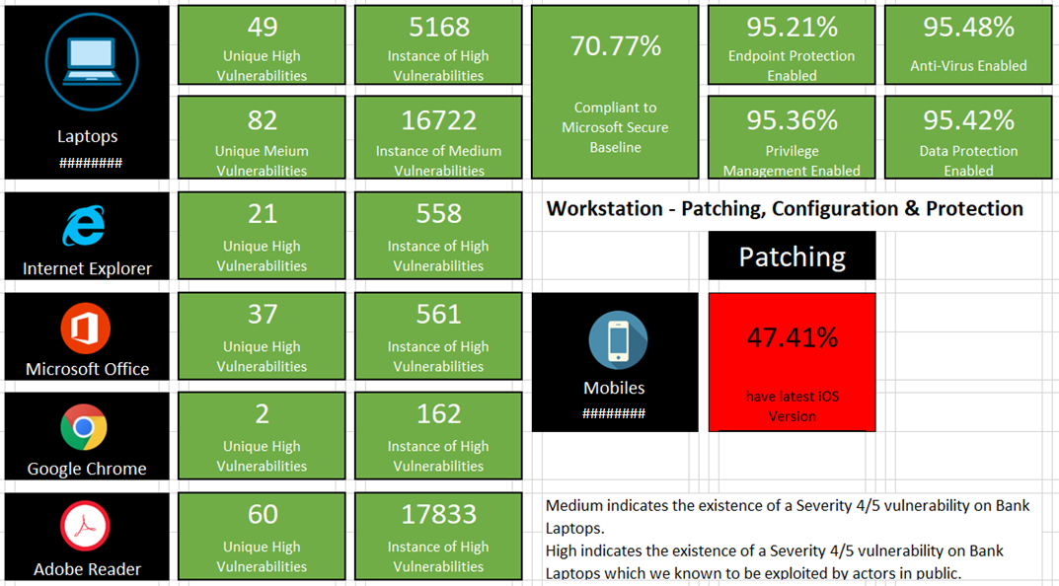






Cyber MI Project
Solving problems by focusing on the practical application of data collection and analysis. Through Data Modelling and Query Design we create interfaces and mechanisms for the flow of information and access to data.
With self-service access to the information, customers will be able to analyse and interpret data to produce their own KPIs and reports.
Data Sources
Cyber Data Engineering Team
C
L
E
V
E
R
Data Wrangling
Cyber Data Lake
Data Views
DaaS
(Data as a Service)
Notes:
Situation: The Bank of England’s mission is to promote the good of the people of the United Kingdom by maintaining monetary and financial stability. As part of the Bank’s Cyber Security division it is our responsibility to understand our Cyber Security Posture. To facilitate this we needed to automate the collection of data from disparate sources within Cyber Security and create a DaaS function within the Bank
Task: The project was also tasked to create processes to engage with data owners, customers and end users to identify. The processes needed to evaluate, collect and aggregate Cyber Security data including Access Management, Vulnerability Management, Penetration Testing, and Human Resources. This data would be make this data available through a DaaS function and produce “single-pane” dashboards to provide users with clear data when they need it.
Actions: To achieve this we engaged with data owners/customers to understand the data they held and how they used it. The project helped them understand the process of data collection and the capability of automation. Using the owner’s data, and aggregating it with additional data sets in the model, the project provided the ability to interrogate and investigate the data at multiple levels. These new abilities drove innovation thought open and transparent data visualisation which improved Cyber Security posture by providing access to information and supporting data-driven decision making.

Slide 4
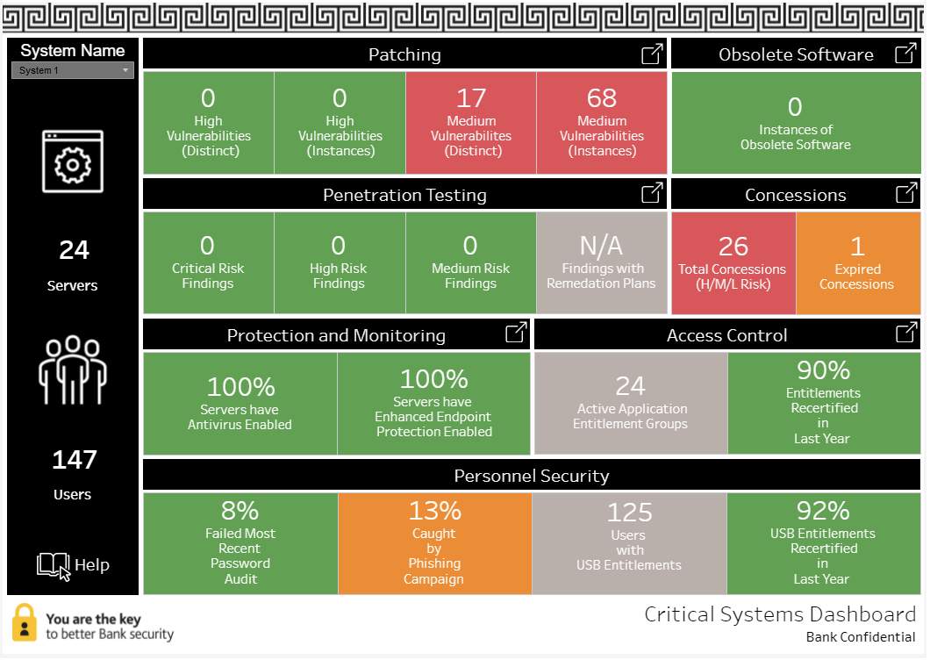
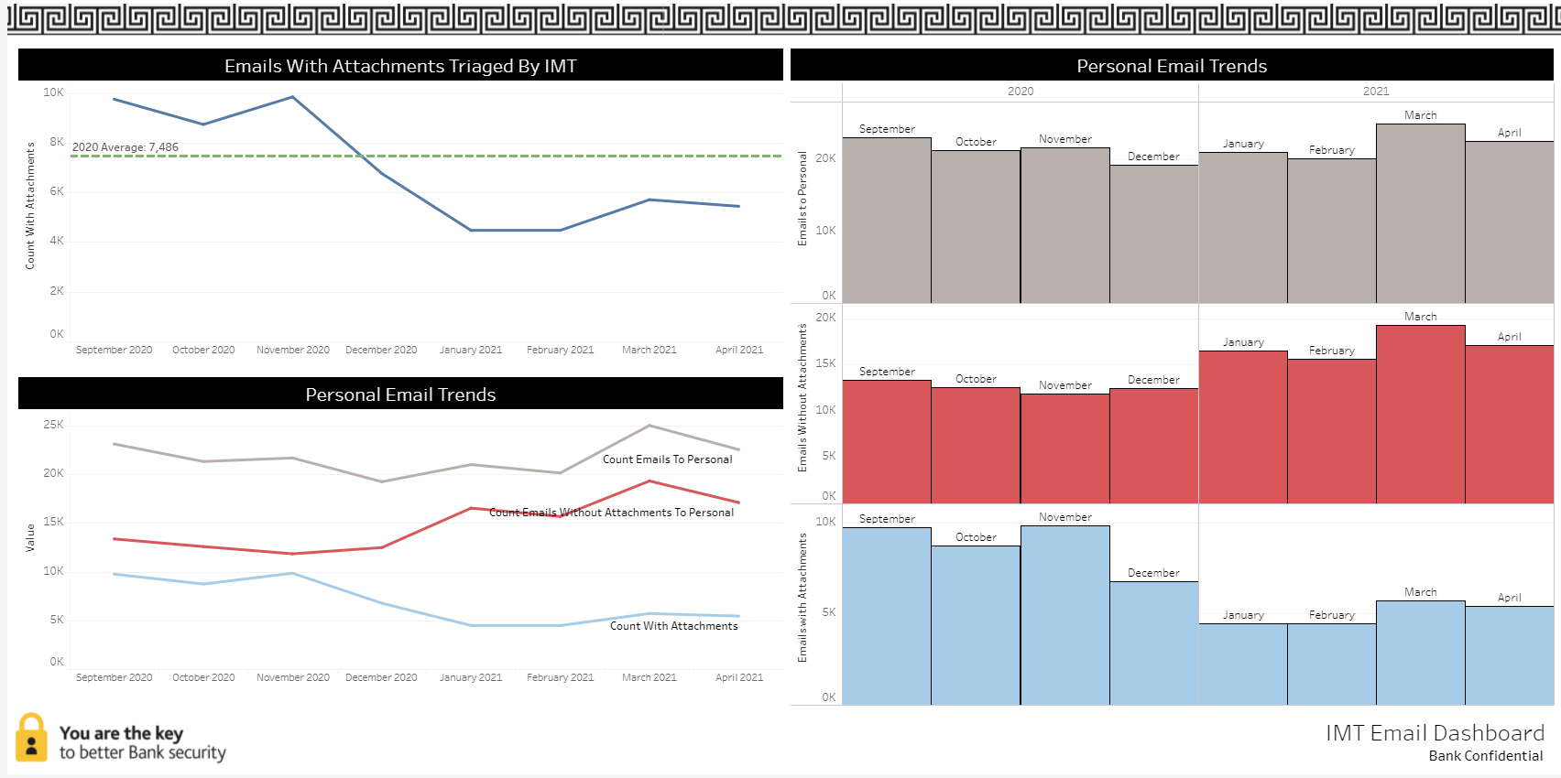
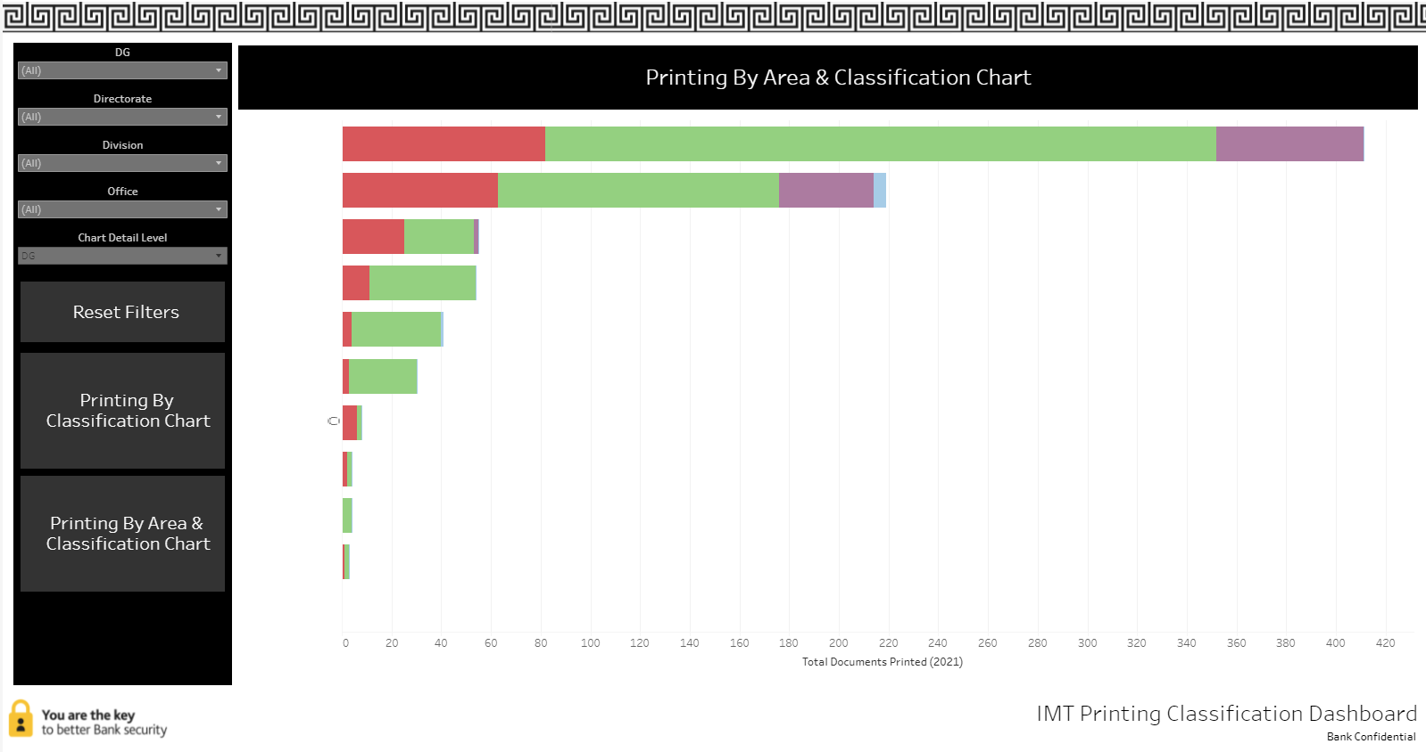
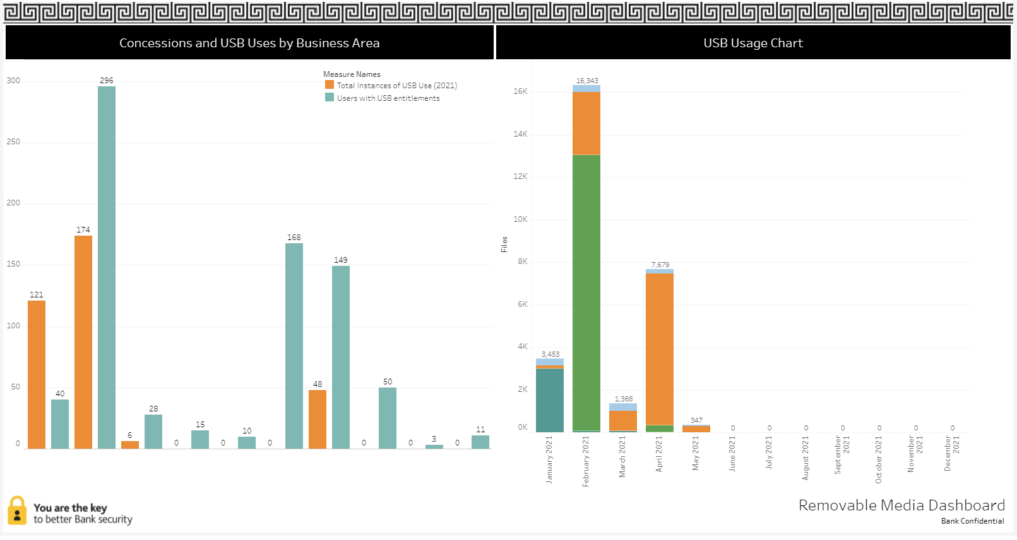
Project Outcomes
“We’ve needed this data but could spare the capacity to manually collect it; what a time saver!”
“The business can talk with the techies using a common language we all agree on”
“For the first time we are seeing a complete pictures of our Cyber Posture”
“This is the data we need, when we need it!”
Data for demonstration purposes only
Notes:
A series of dashboards to provide critical insights into the Bank’s Cyber Security posture. This provides our users (business owners and technical staff) with a common language to discuss Cyber Security and created a new model for system owner engagement with the Cyber Security division.
All dashboards come with comprehensive user guides that have been developed in conjunction with users to ensure that they use clear and understandable language.
So, that is the what, the why, and the who … now the most important piece … how.

Slide 5

How We Got There?
Subject Matter Experts
Business Owners
End Users
Delivery team
People
Success
Requirements capture
Data on-boarding
Feedback
Communications
Development stack
Collaboration tools
Project Tracking Software
Process
Technology
Notes:
Data sources lived in different teams, each with their own processes, policies, and politics for sharing information. By engaging with each data owner on a technical level, we worked closely to identify, classify, and utilise each team’s data. By working with multiple teams we were able to aggregate multiple data sets and create a innovative model that all customers had access to and allowed for new insights into the Bank’s Cyber posture. Where once siloed teams held data close to their chests, we have created an open and collaborative Cyber Data community that promotes the use of data to produce previously unrealised benefits. By engaging with users at numerous technical and managerial levels, we understood their differing needs and worked with each group to produce a cut of the data in the form that was most beneficial for them. The higher the user level, the less detailed information gets retained from any presentation or report. Board executives may only focus on a RAG status, whereas a system SME will require details of the vulnerabilities their application has.
With so many teams, and so much data, we created new customer engagement processes to structure requirements capture, and on-boarding of data feeds. Through the project’s close working relationships with data owners and users, we worked collaboratively, keeping lines of communications constantly open and encouraging feedback.

Slide 6
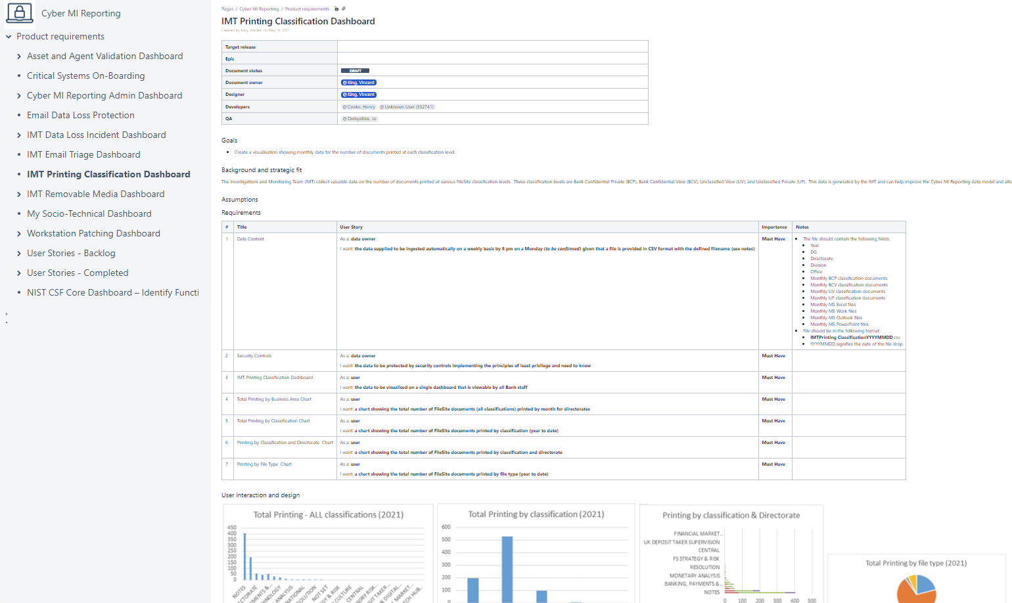
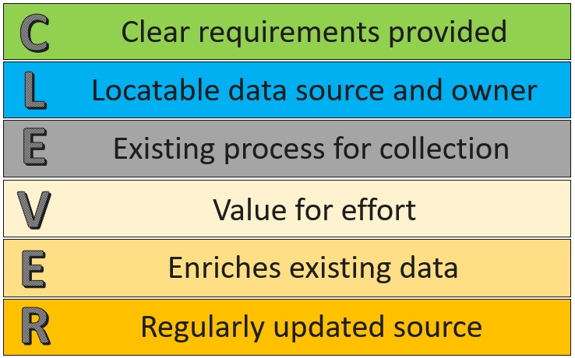
User Engagement Processes
Using newly adopted Agile processes allowed the development team to work closely with product owners, understanding their needs and helping realise the full impact of the solution. Confluence and JIRA allowed the development team to collaborate with customers and receive continuous feedback on output. User engagement allowed for the a brand new client relation model helping to set priorities, create a clear product roadmap, and allow for the swift resolution of issues.
During the project we constantly found new data feeds, and received requests for their inclusion. A specially developed on-boarding process provides clear and concise procedure for requesting the inclusion of new data feeds and outlines the responsibilities of the data owner, processor, and users.
Notes:
Technology within the Bank of England is not a new function, but some ways of working have been slow to be adopted. Capitalising of our new-found desire for the use of the Agile framework the project team used collaboration and work management tools to engage with customers and users on a continuous basis. Through clear lines of communications users were kept up-to-date, given the ability to provide feedback, and helping to resolve issues quickly. This new client relation model proved successful and the project’s processes have been highlighted as best practice within the Bank.
One specially designed process “CLEVER” was created to manage the on-boarding of new data feeds and help manage user expectation during the requirements phase. Following the initial release of the solution, the project was inundated with requests to add data to the model. The CLEVER process allowed the project team to work with users and triage each request. Those that completed the process successfully where added to the project backlog and further engagement with the user was undertaken. Those that were not successful would now know what they needed to do before raising the request again in the future.
But, I think is enough from me on how great things were from the project’s side. I’d like to hand over to Jo Derbyshire, one of our most pro-active data owners/users.

Slide 7





A Word From A CyberMI Reporting User
Regular and clear communications and insights
Delivery of increased benefit through innovation
Open invitation to provide feedback
Managed expectations
Clear and structured engagement process
Notes:
May want to mention
What your team does and the data you receive
The heavy lift/processing carried out by the team
Your obligations to produce stats
Out initiate contact
Open lines of communications
A continuous feedback loop
Your use of the product requirement process
Innovation through the use of other data feeds within CyberMI (HR)
Desire to build more of your team’s work process through CyberMI use and innovation
Due to the success so far want to add additional feeds to realise even greater benefits

Slide 8

Thank You and Questions

